Slide 1

Algebra 1
Unit 11, Lesson 5 Writing Exponential Functions from a Graph or Table Volume 2, pg. 181

Slide 2


Benchmark
MA.912.AR.5.4
Write an exponential function to represent a relationship between two quantities from a graph, a written description, or a table of values within a mathematical or real-world context.
volume 2, pg. 181

Slide 3
Integrated Mathematical Thinking and Reasoning Standards
MA.K12.MTR.1.1 Actively participate in effortful learning both individually and collectively.
MA.K12.MTR.2.1 Demonstrate understanding by representing problems in multiple ways.
MA.K12.MTR.3.1 Complete tasks with mathematical fluency.
MA.K12.MTR.4.1 Engage in discussions that reflect on the mathematical thinking of self and others.
MA.K12.MTR.5.1 Use patterns and structure to help understand and connect mathematical concepts.
MA.K12.MTR.6.1 Assess the reasonableness of solutions.
MA.K12.MTR.7.1 Apply mathematics to real-world contexts.
volume 2, pg. 181

Slide 4

Learning Targets
I can write an exponential function from a graph.
I can write an exponential function from a table.
volume 2, pg. 181

Slide 5

Warm-Up
volume 2, pg. 181

Slide 6
11.5.1 Warm-Up: Growth Mindset
It’s crucial to create an environment where failure, errors, and mistakes are seen as a natural part of learning. Making that environment all starts with you; more specifically, your self-talk.
When you make a mistake, what do you say to yourself?
Explain if what you say to yourself reflects a growth or fixed mindset.
volume 2, pg. 181

Slide 7

Guided Instruction
volume 2, pg. 182

Slide 8
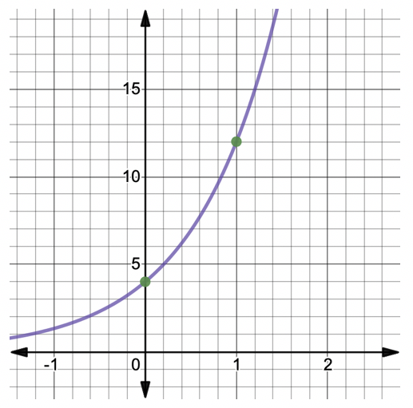
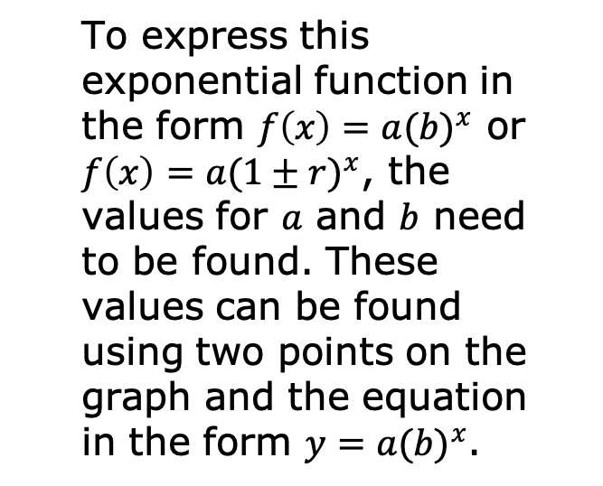
11.5.2 Guided Instruction: Writing an Exponential Function from Graphs and Tables
The graph of an exponential function is shown.
volume 2, pg. 182

Slide 9
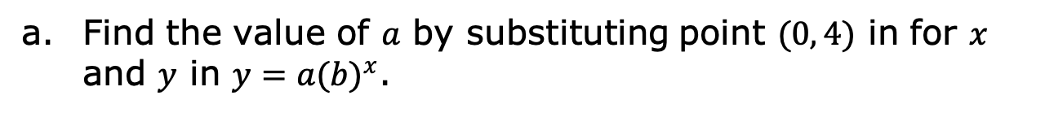

volume 2, pg. 182

Slide 10
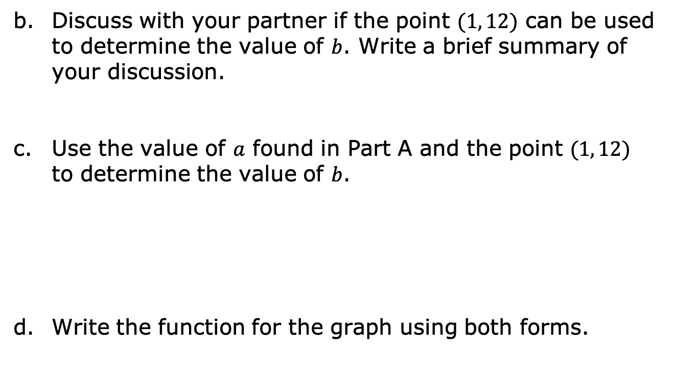

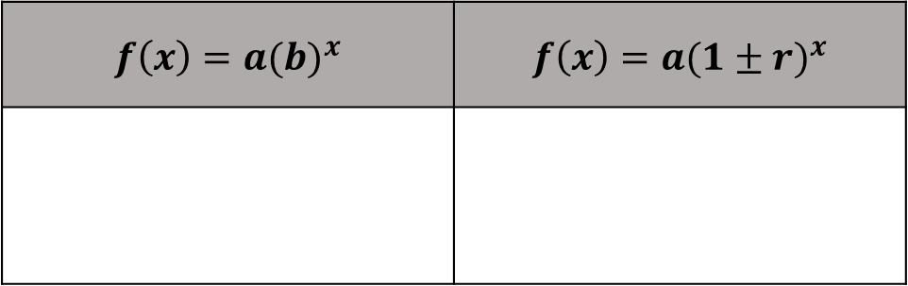
$$f\left(x\right)=a{(b)}^{x}$$ | $$f\left(x\right)=a{(1±r)}^{x}$$
volume 2, pg. 182

Slide 11
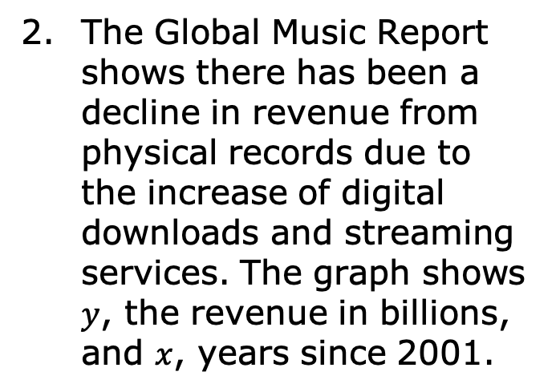
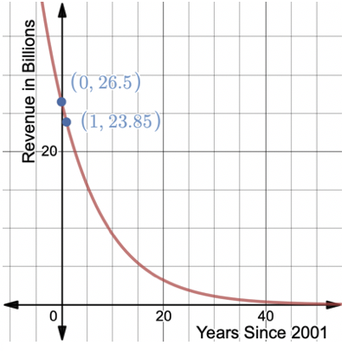
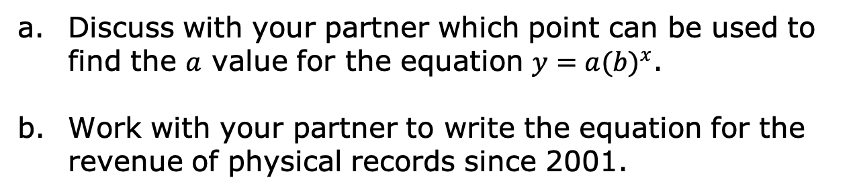
volume 2, pg. 183

Slide 12
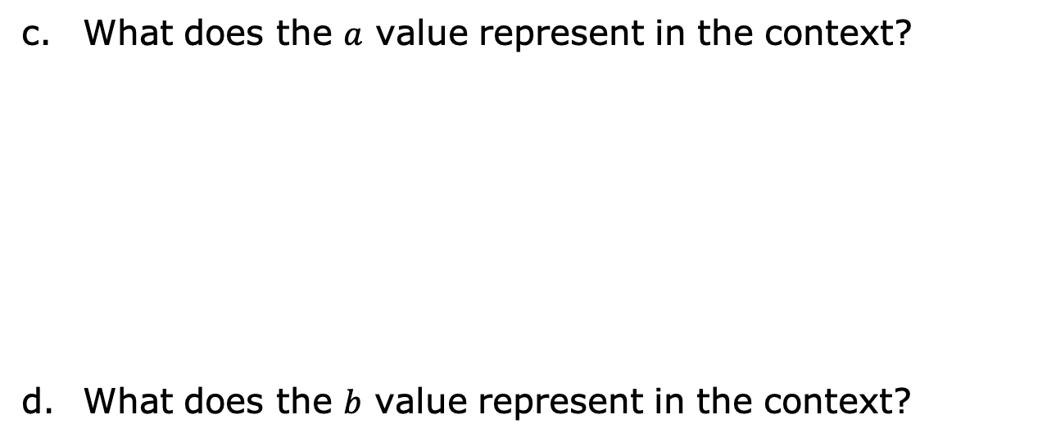
volume 2, pg. 183

Slide 13
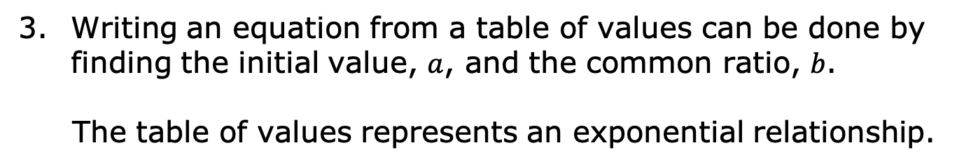
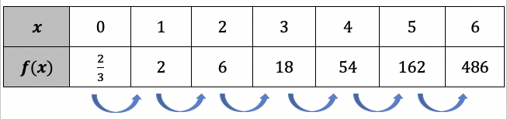
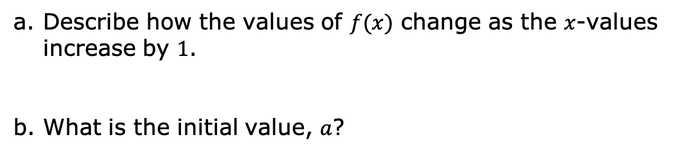
volume 2, pg. 183

Slide 14
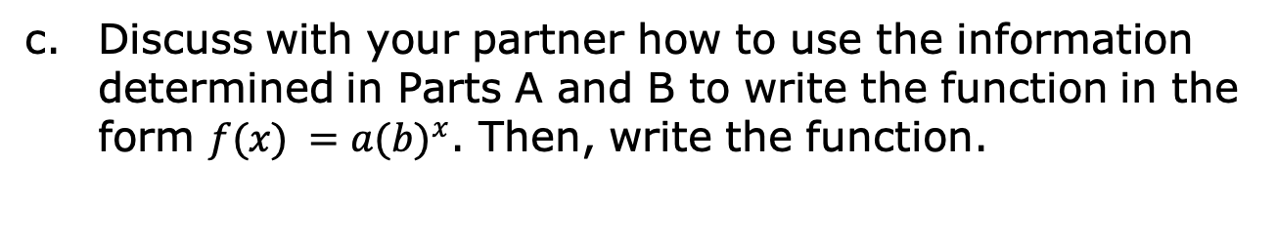
volume 2, pg. 184

Slide 15
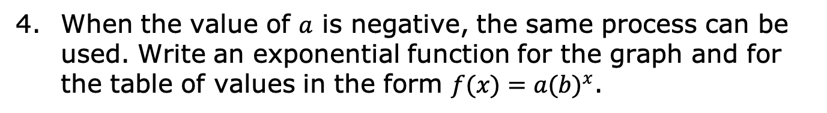
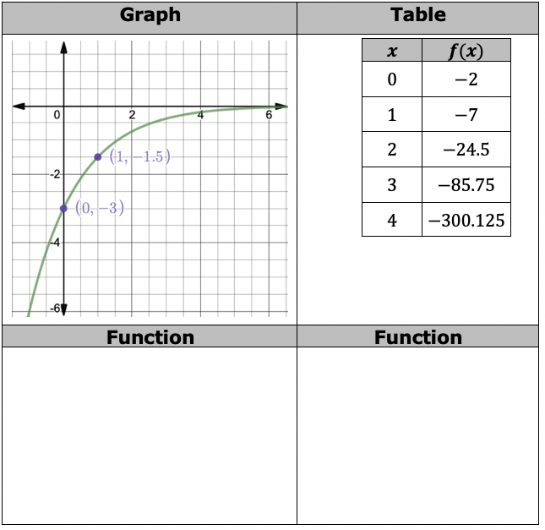
volume 2, pg. 184

Slide 16

Guided Practice
volume 2, pg. 184

Slide 17

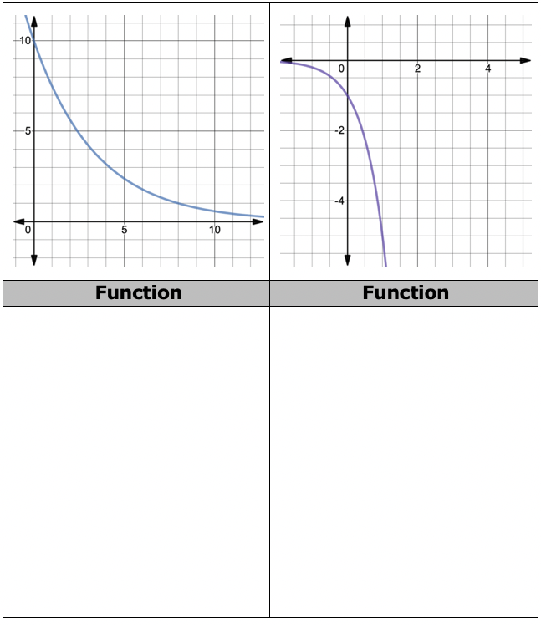
11.5.3 Guided Practice: Writing Exponential Functions
Write the exponential function for each graph.
volume 2, pg. 184

Slide 18
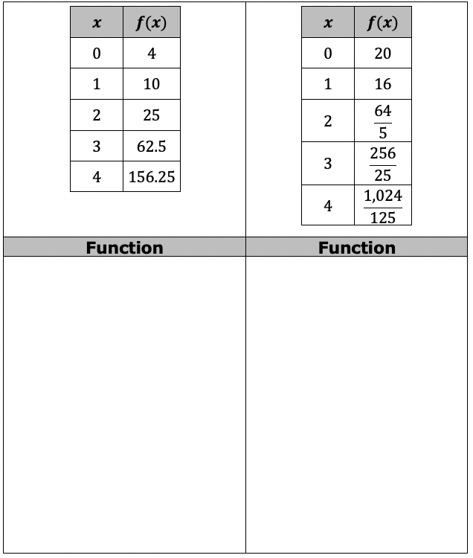
Write an exponential function for each table of values.
volume 2, pg. 185

Slide 19

Wrap-Up
volume 2, pg. 185

Slide 20
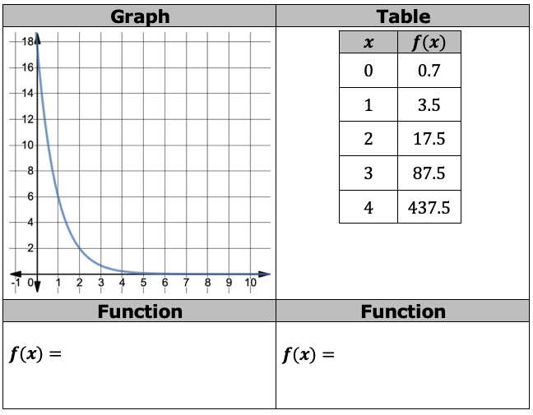
11.5.4 Wrap-Up: Ticket Out the Door
Write the exponential function represented by the graph and the exponential function represented in the table of values.
volume 2, pg. 185

